Slide 1
Utility Management
Operations and Maintenance Best Practices Scoring
BP Scoring Presentation

Slide 2
DCRA Overview
Additional Resources
Best Practices Origin
Best Practices Scoring

Slide 3
Grants & Funding
Bulk Fuel Revolving Loan Program
Serve Alaska
Floodplain Management
Alaska Native Language Preservation
Alaska Regional Development Organizations
Community Resilience Programs
Office of the State Assessor
Local Boundary Commission
ANCSA Municipal Land Trust
Mapping, Analytics, & Data Resources
Local Government Assistance
Rural Utility Business Advisors
Made in Alaska

Slide 4
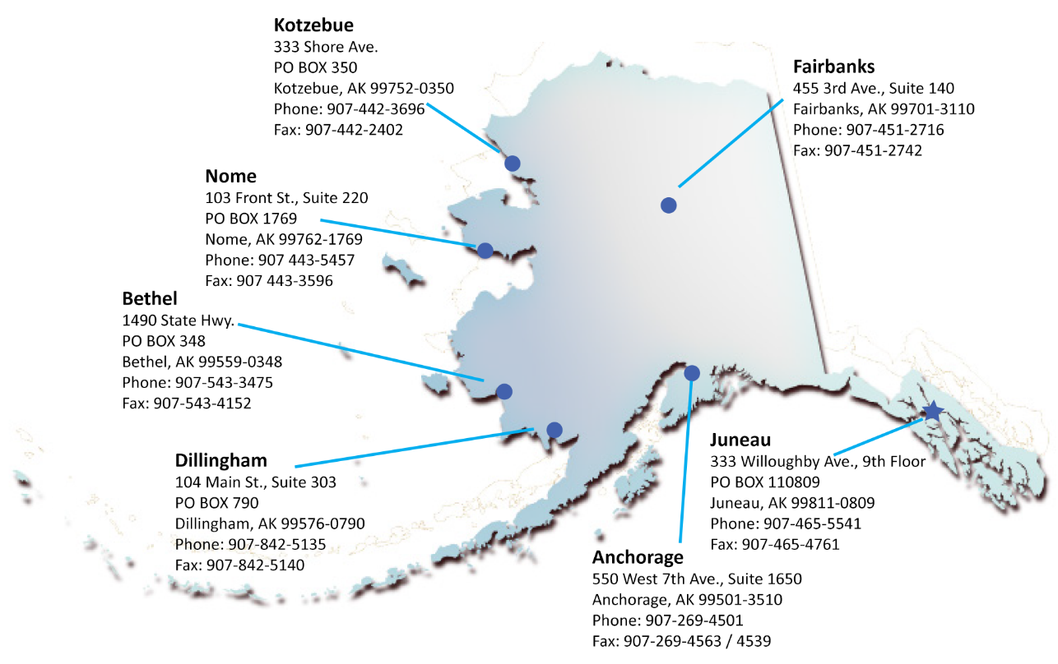

Slide 5
Elections
Alaska Statute Title 29
Financial Management
Community Service Provision
Local Government Specialists
Personnel Management
Power Cost Equalization
Title 4 Local Option Laws
Elected Officials trainings
Ordinances, Resolutions, Codes
Pandemic support

Slide 6
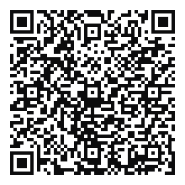
Find your Local Government Specialist
https://dcced.maps.arcgis.com/apps/webappviewer/index.html?id=39d62deddd2b49c3b9a1aff48ffcaa76

Slide 7

  Operations and Maintenance Best Practices

Slide 8
1996 Federal Safe Drinking Water Act Amendment (SDWA)
  Section 119 requires state drinking water primacy programs to:
  Prevent the creation of nonviable community and non-transient non-community water systems;
  Develop a strategy to address the capacity of all existing water systems.
  “Capacity” is the capabilities required of a public water system to achieve and maintain compliance with drinking water regulations, including 3 elements:
    Technical capacity
    Managerial capacity
    Financial capacity

Slide 9
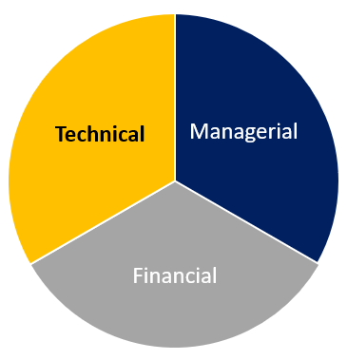
Alaska’s Strategy
  Assess small community system capacity using the Best Practices scoring criteria.
  The Best Practices (BP) scoring criteria reflects the capacity elements discussed in the 1996 SDWA.

Slide 10
Alaska’s Strategy
Technical
Operator certification
Preventative maintenance plan
Drinking water program compliance
Managerial
Utility management training
Meetings of the governing body
Financial
Budget
Revenue
Workers’ compensation
Payroll tax liability

Slide 11
RUBA’s Role in Best Practices
  DCRA’s Rural Utility Business Advisors (RUBA) Program is an EPA grant-funded partner with DEC, to carry out elements of DEC’s State of Alaska Strategy:
  Conduct Best Practices scoring of Managerial & Financial elements.
  Help utilities improve capacity by:
    Providing one-on-one and small group training and assistance
    Creating training materials and templates
    Utility Management classes

Slide 12
Sanitation Deficiency System (SDS)
Used by some federal and state funding programs to rank construction projects as part of the overall score
Village Safe Water (VSW) Capital Improvement Project (CIP)
Score determines competitiveness
Minimum BP score required to qualify for funding

Slide 13
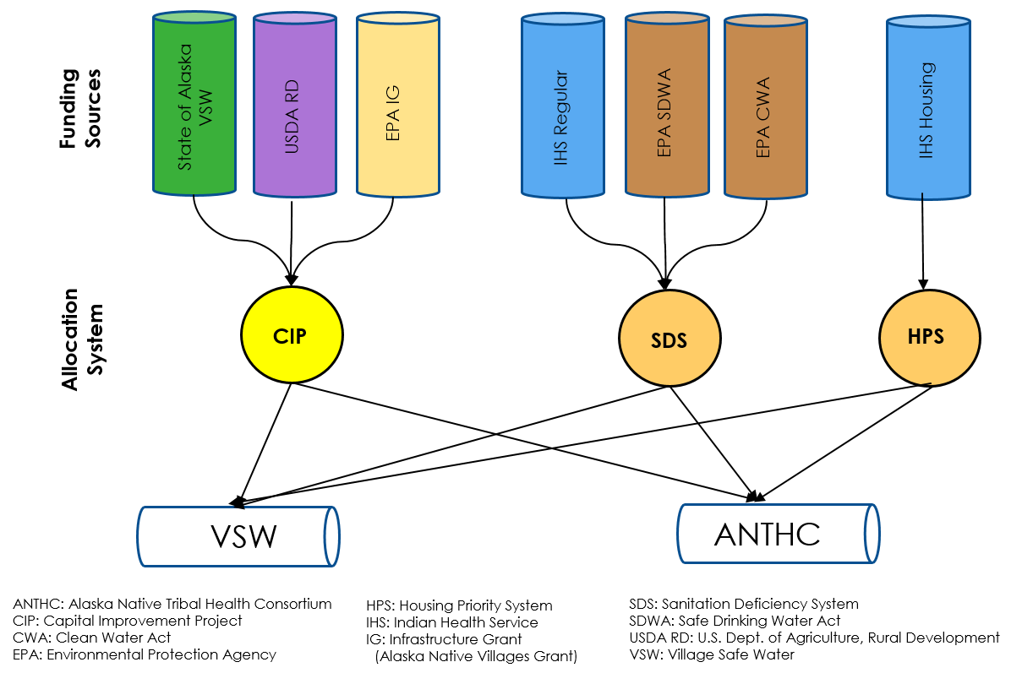

Slide 14
Health impact
0 to 30 points
Project deficiency level
0 to 25 points
Adequate previous service
0 to 4 points
Capital cost
-9 to 9 points
BP score (O&M capacity)
0 to 16 points
Local contribution
0 to 8 points
Local tribal priority
0 to 16 points
Total 108 Points
Other considerations
15 to 0 points

Slide 15
Minimum BP score:
Dependent upon:
Type of project being requested
Current service level of the community

Slide 16
100 Points Possible
Technical capacity
45 points possible
Scored by DEC
Managerial capacity
10 points possible
Scored by RUBA
Financial capacity
45 points possible
Scored by RUBA

Slide 17
Utility Management Training
  Why is this important to managing water & wastewater utilities?
  RUBA courses focus specifically on the management of rural Alaska water and wastewater systems.
  Courses address topics important to managing utilities in sustainable long-term ways.
  Courses provide utility staff with skills needed to succeed at providing communities with clean and safe water and wastewater.

Slide 18
Utility Management Training – 5 Points
A person who holds a position of responsibility for management of the utility has completed a DCRA approved Utility Management course or other utility management training course within the last 5 years. | 5 points
[No qualifying training has been completed in the last 5 years by a person currently in a position of responsibility for management of the utility.] | 0 points

Slide 19
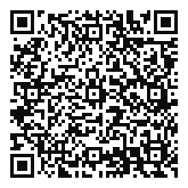
Utility Management Training – FREE!
  Available both online and in-person
  Available in Anchorage and regional offices
  32-hours completed in 5-7 days
  Travel & lodging scholarships available
Introduction
Personnel
Financial
Planning
Operations
Organizational
Elected Officials
Clerks
QuickBooks

Slide 20
Meetings of the Governing Body – 5 Points
  Why is this important to managing water & wastewater utilities?
  The governing body makes the ultimate decisions for your utility such as how to fund it and how to ensure its sustainability.
  The governing body must be meeting regularly in order to make decisions about the utility.
  The governing body must be receiving adequate information about the utility to make proper informed decisions.

Slide 21
Meetings of the Governing Body – 5 Points
The utility owner’s governing body meets routinely consistent with the local ordinance/bylaw requirements and receives a current report from the operator. | 5 points
The utility owner’s governing body meets routinely consistent with the local ordinance/bylaw requirements. | 2 points
The utility owner’s governing body does not meet | 0 points

Slide 22

Meetings of the Governing Body – 5 Points
  For Maximum 5 points:
  Governing body = the city council, borough assembly, tribal council, or community association board.
  Meetings take place in accordance with local ordinances/bylaws – often once per month.
  Minutes must be provided for a majority of the last 12 months.
  Minutes must be reviewed and approved by the governing body.
  Minutes must indicate that a written or oral report was received from the operator or contracted utility manager (such as ARUC) – labeled “Water Operator Report”.
  Minutes must indicate that financial reports are received and reviewed (this will come into play in the next section).

Slide 23
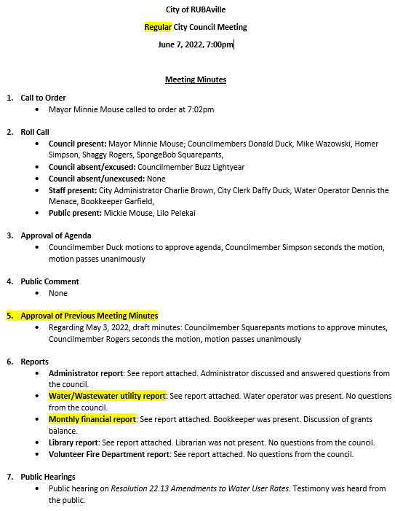

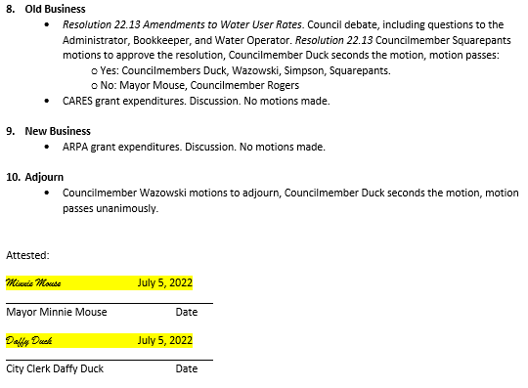
Model Minutes – 5 points
  Governing body = the city council, borough assembly, tribal council, or community association board.
  Meetings take place in accordance with local ordinances/bylaws – often once per month.
  Minutes must be provided for a majority of the last 6 months.
  Minutes must be reviewed and approved by the governing body.
  Minutes must indicate that a written or oral report was received from the operator or contracted utility manager (such as ARUC) – labeled “Water Operator Report”.
  Minutes must indicate that financial reports are received and reviewed (this will come into play in the next section).

Slide 24
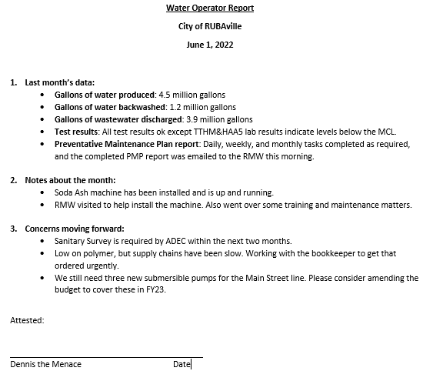
Operator Report - Example

Slide 25
Budgets – 15 Points
  Why is this important to managing water & wastewater utilities?
  It is the responsibility of the governing body to make decisions regarding how a utility will be funded, how it will spend its money, how it will receive revenue, etc.
  The governing body must communicate this fiscal plan to utility staff in a clear way – a budget is the best way to do this.
  A budget shows utility staff how they may spend and receive money.
  A budget allows a governing body to make long-term decisions about utility management and operations, such as how much to charge for services, how much to pay staff, and how and when to fund maintenance needs, among many others.

Slide 26
Budget – 15 Points
Utility owner and the utility have each adopted a realistic budget and budget amendments are adopted as needed; accurate monthly financial reports are prepared and submitted to the governing body. | 15 points
Either the utility or the utility owner has adopted a budget, but the other has not. | 13 points
Either the utility or the utility owner has adopted a budget, but it is not being implemented. | 10 points
Utility owner and the utility have not adopted a budget. | 0 points

Slide 27
Budget – 15 Points
  For maximum 15 points:
  Budget must be adopted by the governing body.
  Budget must be balanced (revenues ≥ expenses).
  Budget must be realistic (consider past budgets, current situations, business plans, etc.).
  Income & expenses must be detailed.
  Utility enterprise shown separate from other functions of the owner.
  If subsidies are depended upon, they must be identified and documented, and tracked in monthly financial reports.
  Budget must be tracked via monthly financial reports.
  Monthly financial reports must be in cash basis, and compare budget-to-actual year-to-date.
  Governing body’s meeting minutes must show that reports are received & reviewed.
  Budget amendments as needed.

Slide 28
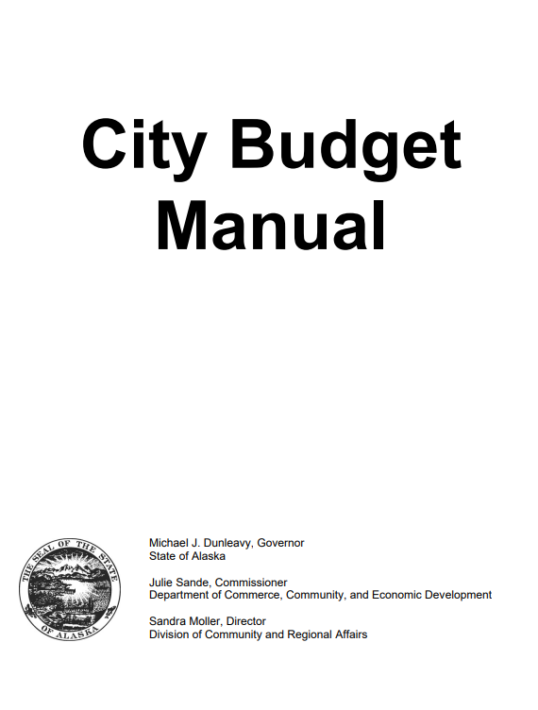

Budget – City Manual
https://www.commerce.alaska.gov/web/Portals/4/pub/BudgetManual.pdf

Slide 29
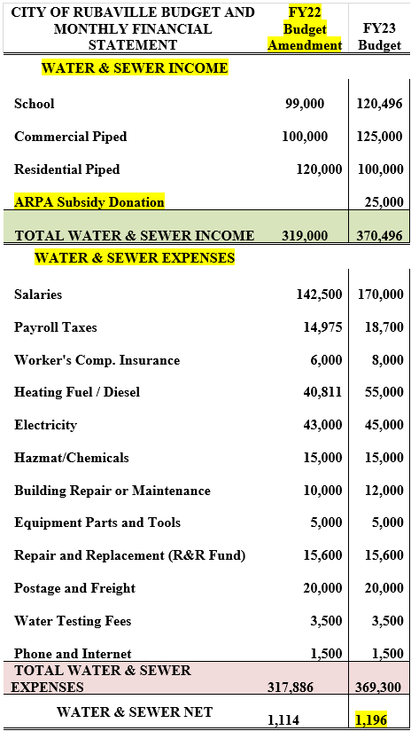
Model Budget – 15 Points
  “Overall Budget” – must cover both utility & the overall organization.
  Budget must be adopted by the governing body.
  Budget must be balanced (revenues ≥ expenses).
  Budget must be realistic (consider past budgets, current situations, business plans, etc.).
  Income & expenses must be detailed.
  Utility enterprise shown separate from other functions of the owner.
  If subsidies are depended upon, they must be identified and documented, and tracked in monthly financial reports.
  Budget must be tracked via monthly financial reports.
  Monthly financial reports must be in cash basis, and compare budget-to-actual year-to-date.
  Governing body’s meeting minutes must show that reports are received & reviewed.
  Budget amendments as needed.

Slide 30
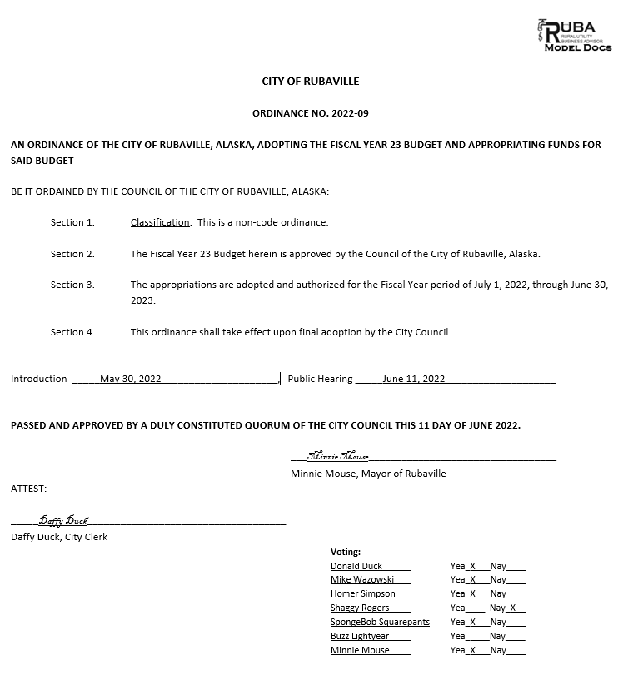
Budget – Model Ordinance
  Reference to the budget
  Public hearing
  Adoption by majority of the governing body

Slide 31
Revenue – 20 Points
  Why is this important to managing water & wastewater utilities?
  A utility must collect sufficient revenue to cover all expenses.
  Expenses necessary for a utility to operate include but are not limited to: heating fuel, electricity, chemicals, water testing, salaries, parts, equipment, and much more.
  If sufficient revenue is not collected, consequences can include:
    Staff not being paid = staff retention issues = a failed utility.
    Insufficient funds for day-to-day operations = a failed utility.
    Insufficient funds for repairs and replacements = a failed utility.
  Monthly financial reports are necessary to track revenue throughout the budget year.

Slide 32
Revenue – 20 Points
Utility is collecting revenue sufficient to cover the utility’s operating expenses and to contribute to a repair and replacement account. | 20 points
Utility is collecting revenue sufficient to cover operating expenses. | 15 points
Utility has a fee schedule and a collection policy that is followed. | 5 points
Utility has no fee structure or collection policy. | 0 points

Slide 33
Revenue – 20 Points
  For maximum 20 points, Monthly Financial Reports must show:
  All revenues and expenses.
  Budget versus Actual.
  Year-to-date.
  Cash basis.
  Show sufficient revenue either from user fees or explicitly identified subsidies or a combination of both.
  Contribution made to a Repair and Replacement account (see next slide).

Slide 34
Revenue – 20 Points
  For maximum 20 points, Monthly Financial Reports must show Repair & Replacement (R&R):
  R&R funds are set aside for all parts which need to be replaced every 1-7 years.
  R&R line-item budget allocation and tracking on monthly financial reports.
  At least quarterly contributions to the annual budgeted allocation to R&R.
  The utility may already have sufficient funds designated to meet projected R&R costs – if so, provide evidence.

Slide 35
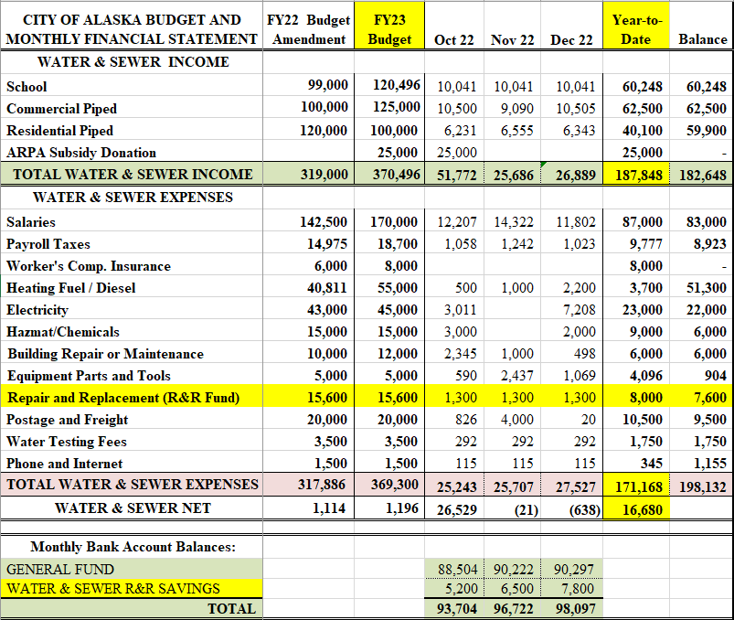
Model Financial Report – 20 points
  All revenues and expenses
  Budget versus Actual
  Year-to-date
  Cash basis
  Show sufficient revenue either from user fees or explicitly identified subsidies or a combination of both
  Contributions made to a Repair and Replacement account

Slide 36
Workers’ Compensation – 5 Points
  Why is this important to managing water & wastewater utilities?
  If a worker is injured or killed on the job, and the utility does not have workers compensation insurance, the utility is responsible for all costs, which can bankrupt the utility.
  Current workers compensation insurance is required by both state and federal law.
  Fines & penalties can be assessed for noncompliance.
  Noncompliance can result in projects being delayed, halted, or taken out of consideration.

Slide 37
Workers’ Compensation Insurance – 5 points
Utility has had a workers’ compensation insurance policy for all employees for the past two years and has a current policy in place. | 5 points
Utility has a workers’ compensation insurance policy for all employees. | 2 points
Utility has no workers’ compensation policy. | 0 points

Slide 38
Workers’ Compensation – 5 points
  For maximum 5 points:
  Current workers compensation insurance
  Continuous workers compensation insurance for the last 2 years
  As evidenced by one or more of the following:
  Department of Labor Workforce Development database
  From the insurance carrier
  From the utility, if no other evidence is available:
    Must provide proof of current coverage
    Must provide proof of current payment

Slide 39
Payroll Liability Compliance – 5 Points
  Why is this important to managing water & wastewater utilities?
  Payroll tax compliance is required by both federal and state law.
  It is the right thing to do for your employees.
  Noncompliance results in very expensive fines and penalties.
  Noncompliance can lead to liens and seizure of your property.

Slide 40
Payroll Liability Compliance – 5 points
Utility has no past due tax liabilities and is current with all tax obligations. | 5 points
Utility owes back taxes, but has a signed payment agreement, is current on that agreement, and is up-to-date with all other tax obligations. | 2 points
Utility is not current with its tax obligations and/or does not have a signed payment agreement for back taxes owed. | 0 points

Slide 41
State Payroll Liability
  State of Alaska Employment Security contribution taxes:
    https://online-tax.alaska.gov/ATP/WebDoc/_/#1
  RUBA QuickBooks Hotline support:
    907-440-0242.

Slide 42
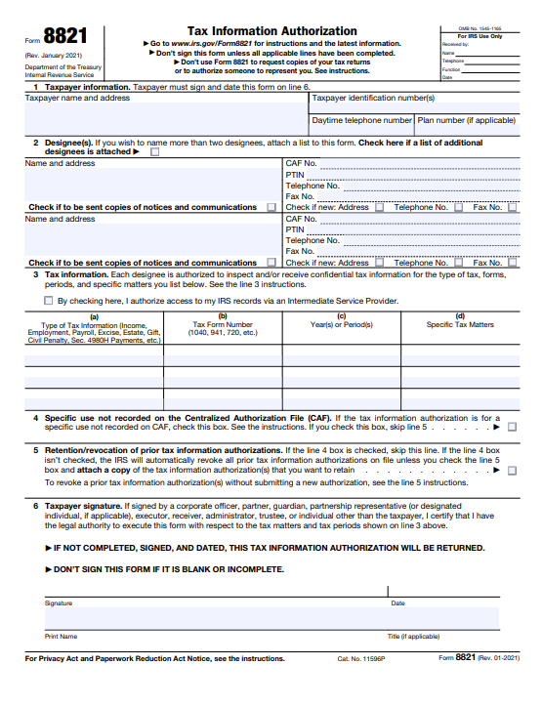
Payroll Liability Compliance – 5 Points
  File all reports in a timely accurate manner
  Make all payments in a timely accurate manner

Slide 43
Federal Payroll Liability Compliance
  This is no longer required for Best Practices scoring. However, it is very important. RUBA can still help you attain and remain IRS compliant! Here’s how:
  E-Filing (not required, but much more reliable):
    https://www.irs.gov/payments/eftps-the-electronic-federal-tax-payment-system
  Sign an 8821 form with your LGS for ongoing assistance
  RUBA QuickBooks Helpline support:
    907-440-0242.
  IRS support for nonprofit & government entities:
    1-877-829-5500.
  If IRS is not able to help, contact Taxpayer Advocates Service (TAS) assistance
    Form 911

Slide 44
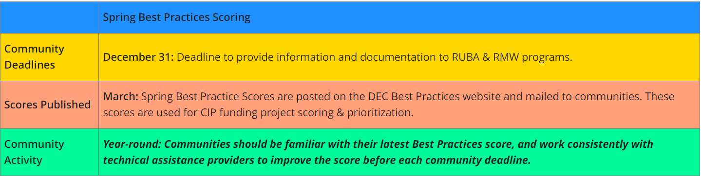
Scoring is conducted 1 time a year
  January (documents due to your LGS December 31)
    Published in the spring
  However: please submit documents monthly, in order to catch issues and improve practices as you go, rather than waiting until the end when it’s too late.

Slide 45




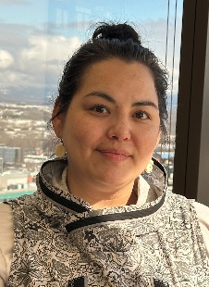



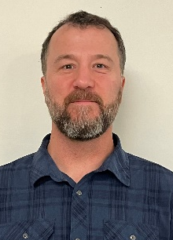



Your Local Government Specialist (LGS) will assist you!

Slide 46

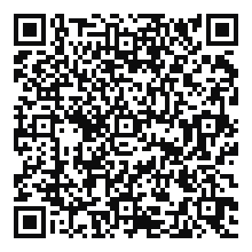
Model Documents & Templates
  https://www.commerce.alaska.gov/web/dcra/LocalGovernmentResourceDesk/BestPracticesToolkit.aspx

Slide 47



RUBA QuickBooks Hotline: (907) 440-0242
  Hotline
  Classes
  Visits
  Intensive

Slide 48
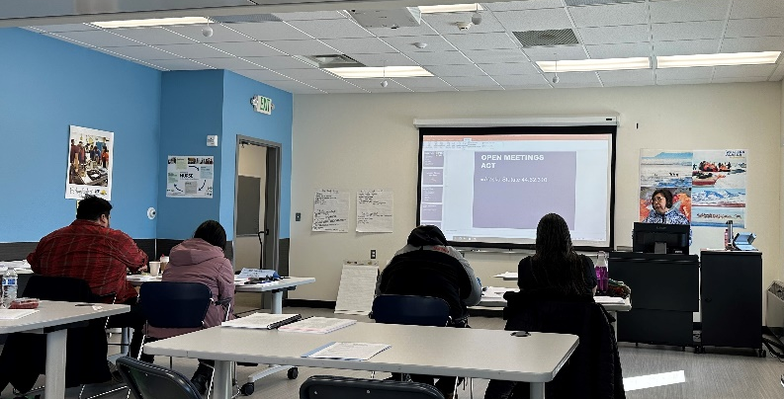
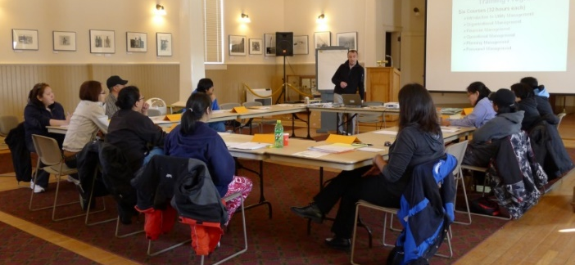
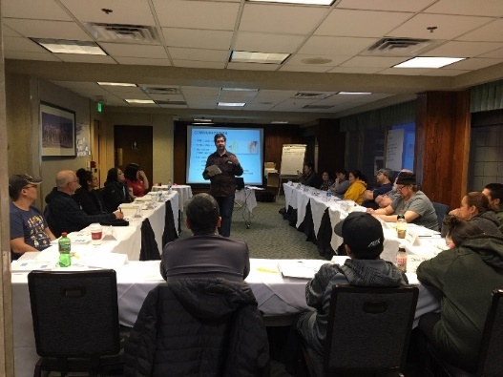
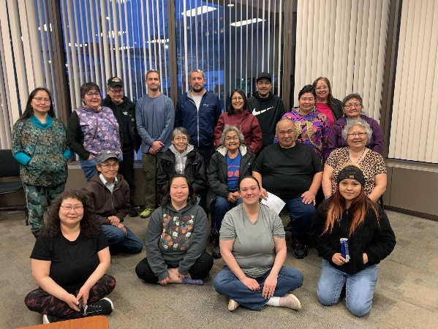
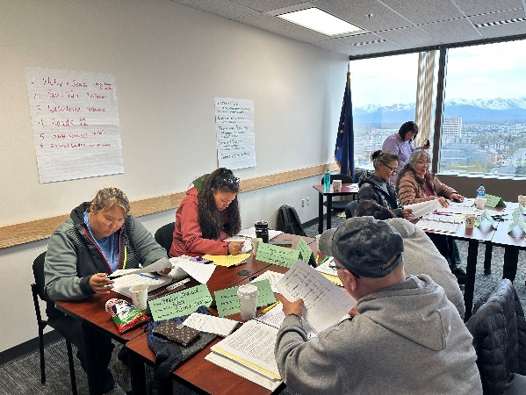
Travel Scholarship Available!

Slide 49


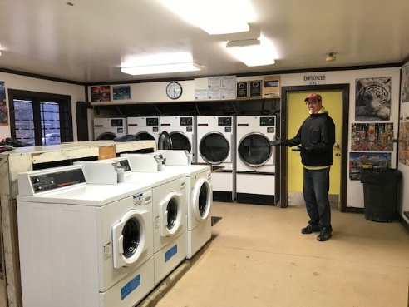

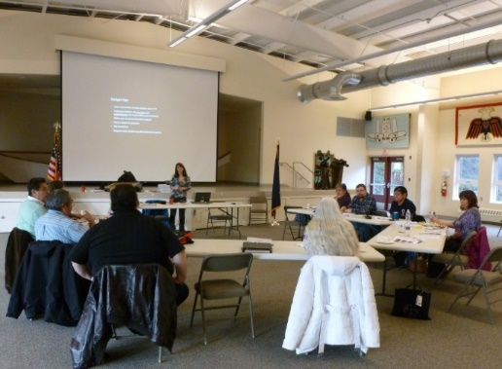
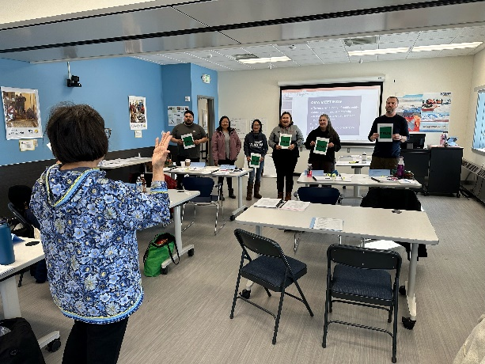

Slide 50
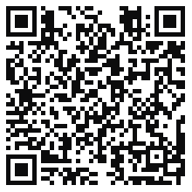
Local Government Resource Desk
ResourceDesk@alaska.gov
Find your Local Government Specialist
https://dcced.maps.arcgis.com/apps/webappviewer/index.html?id=39d62deddd2b49c3b9a1aff48ffcaa76

